Slide 1
After Installing Kali Linux

Slide 2
Content
Update Kali Linux
Changing the default Password
Install Proton VPN
Install Tor Browser

Slide 3
Update Kali Linux

Slide 4
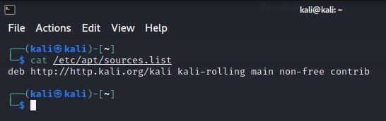
How to Update Kali Linux?
Check the Source List Files
cat /etc/apt/sources.list
Check Kali Linux Release
cat /etc/os-release
Update the apt package list
sudo apt update
Upgrade the System
sudo apt dist-upgrade -y
Remove Unnecessary Packages
sudo apt autoremove

Slide 5
Changing the default Password

Slide 6
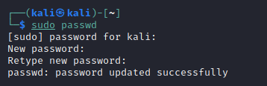
Changing the default Password
Change Root Password
sudo su
passwd

Slide 7
Proton VPN

Slide 8
How to install a ProtonVPN on Kali Linux?
Download the ProtonVPN DEB package
https://protonvpn.com/download/protonvpn-stable-release_1.0.0-1_all.deb
Install the ProtonVPN repository
sudo apt install /home/kali/Downloads/protonvpn-stable-release_1.0.0-1_all.deb
Update the apt package list
sudo apt update
Install the app
sudo apt install protonvpn

Slide 9
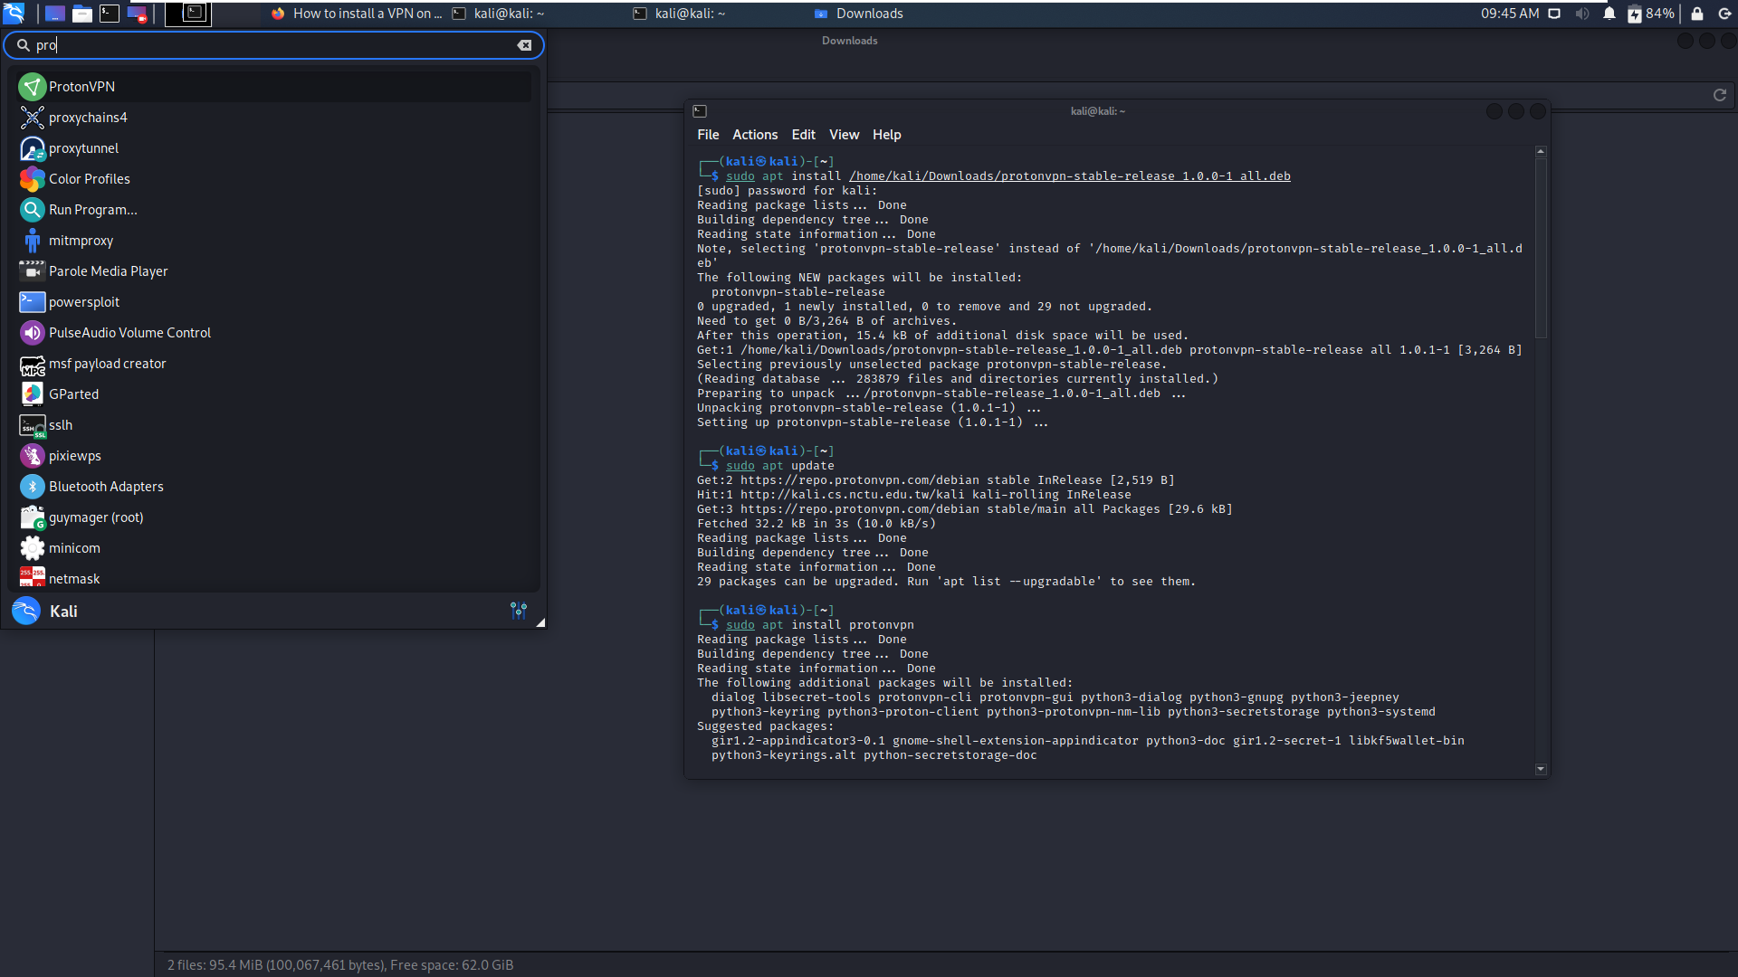

Slide 10
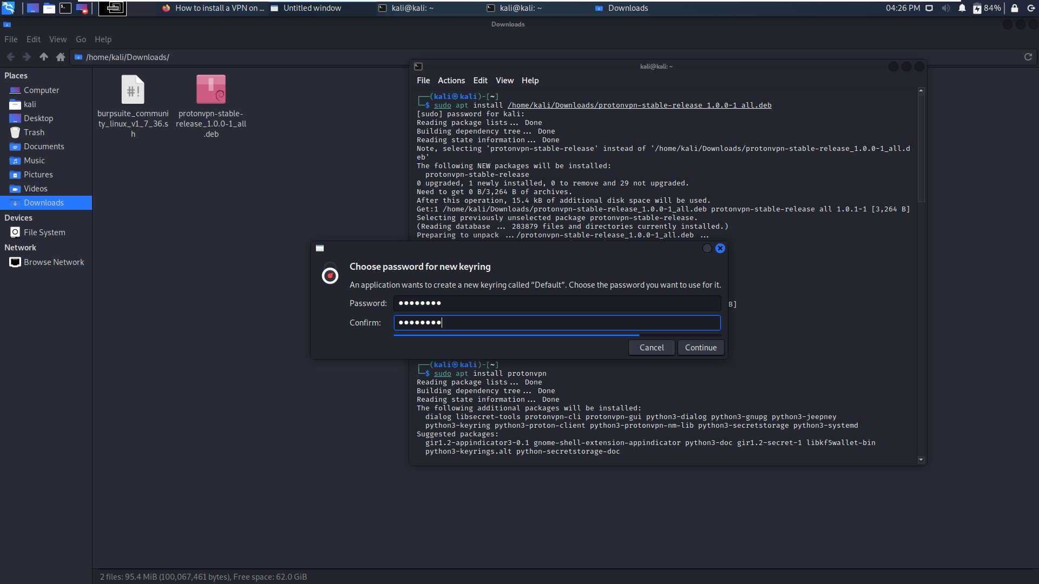
Notes:
nkr@VPVN

Slide 11
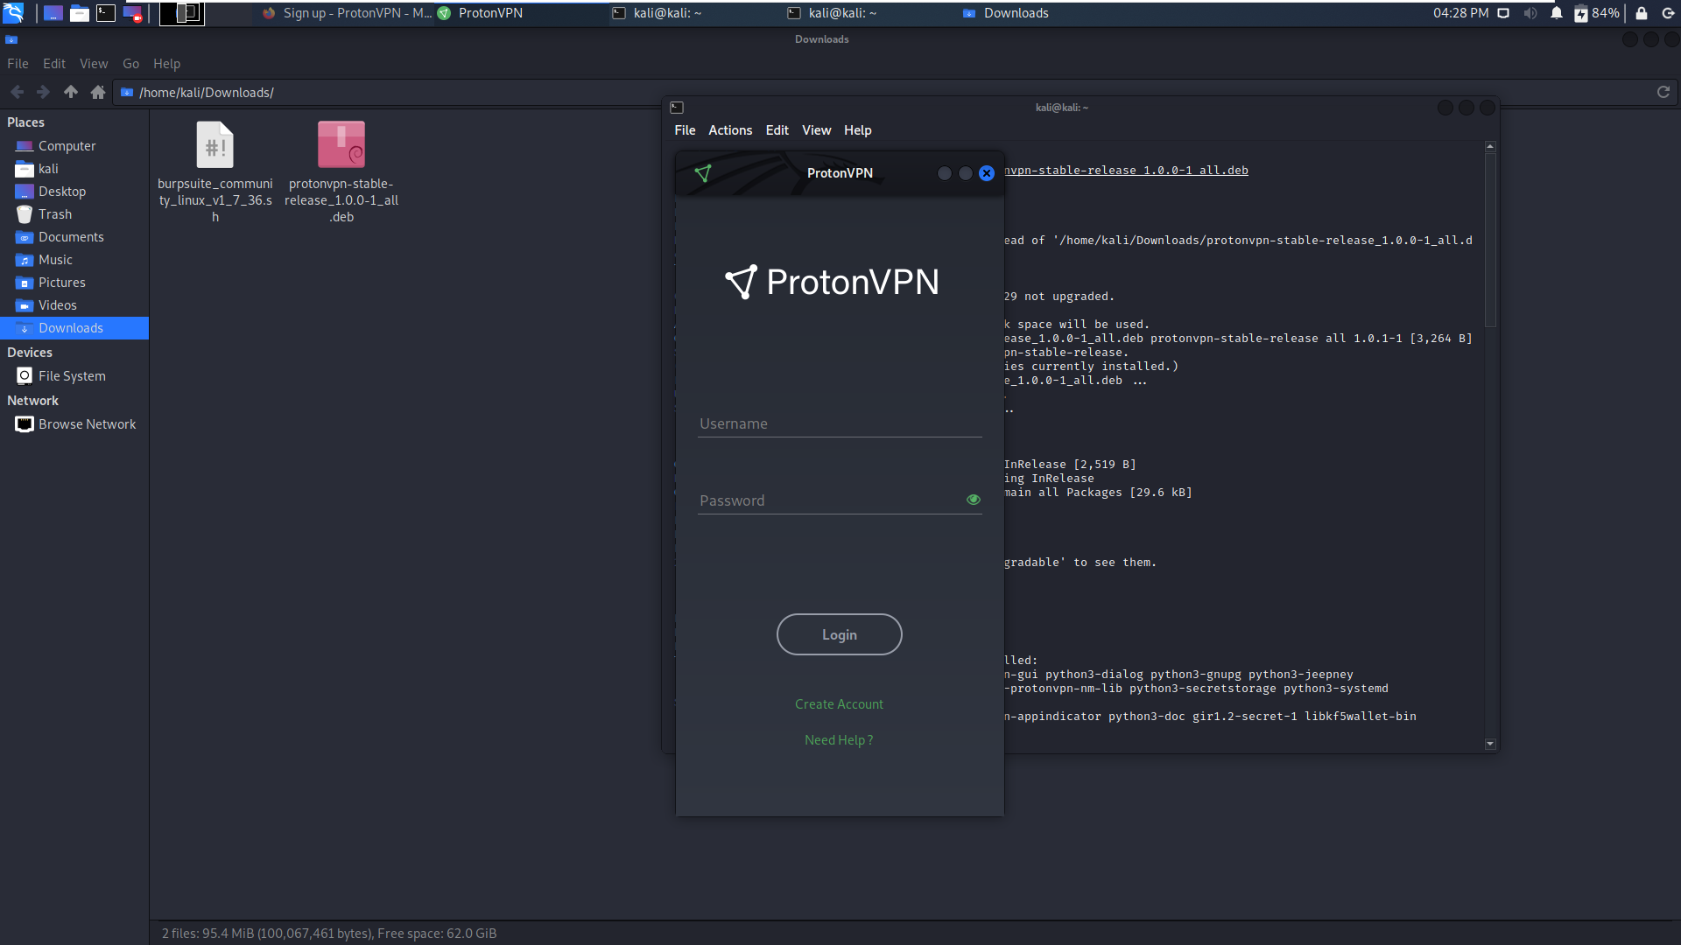

Slide 12
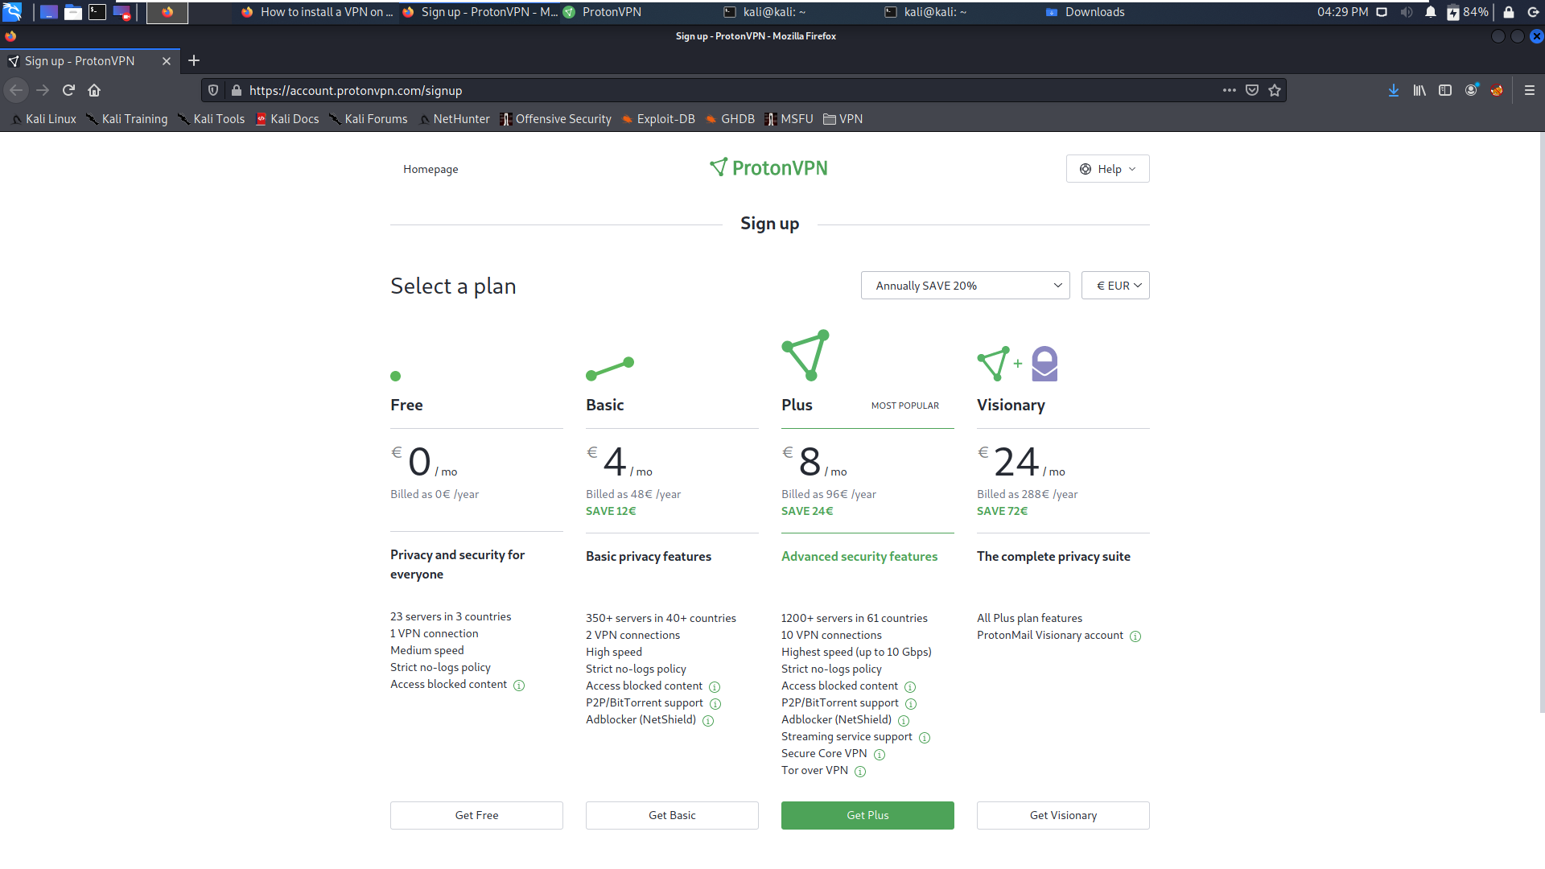

Slide 13
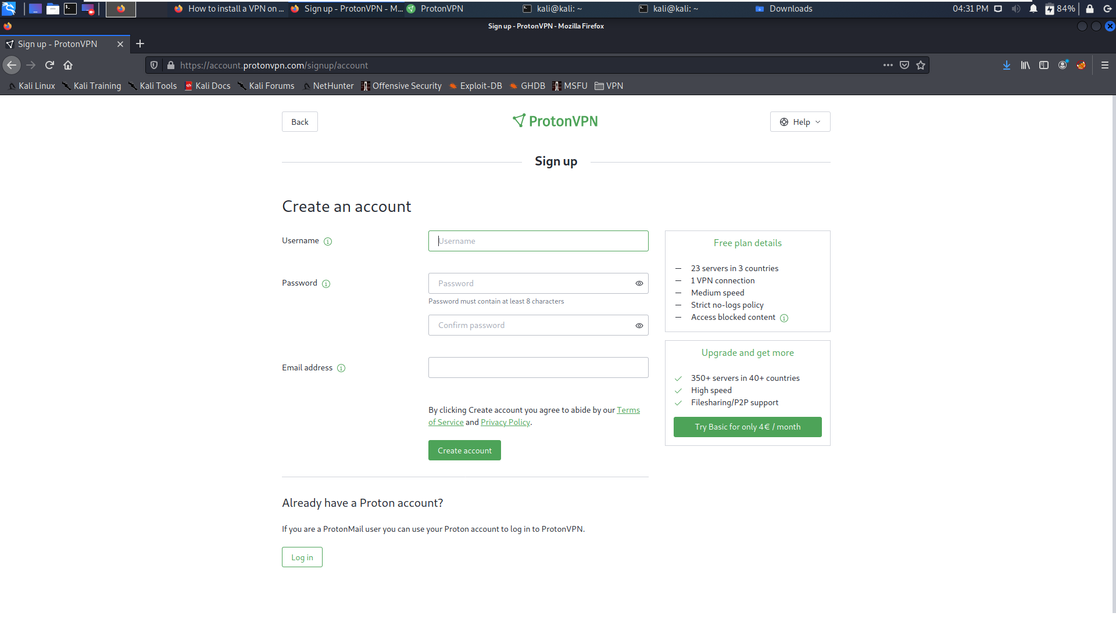

Slide 15
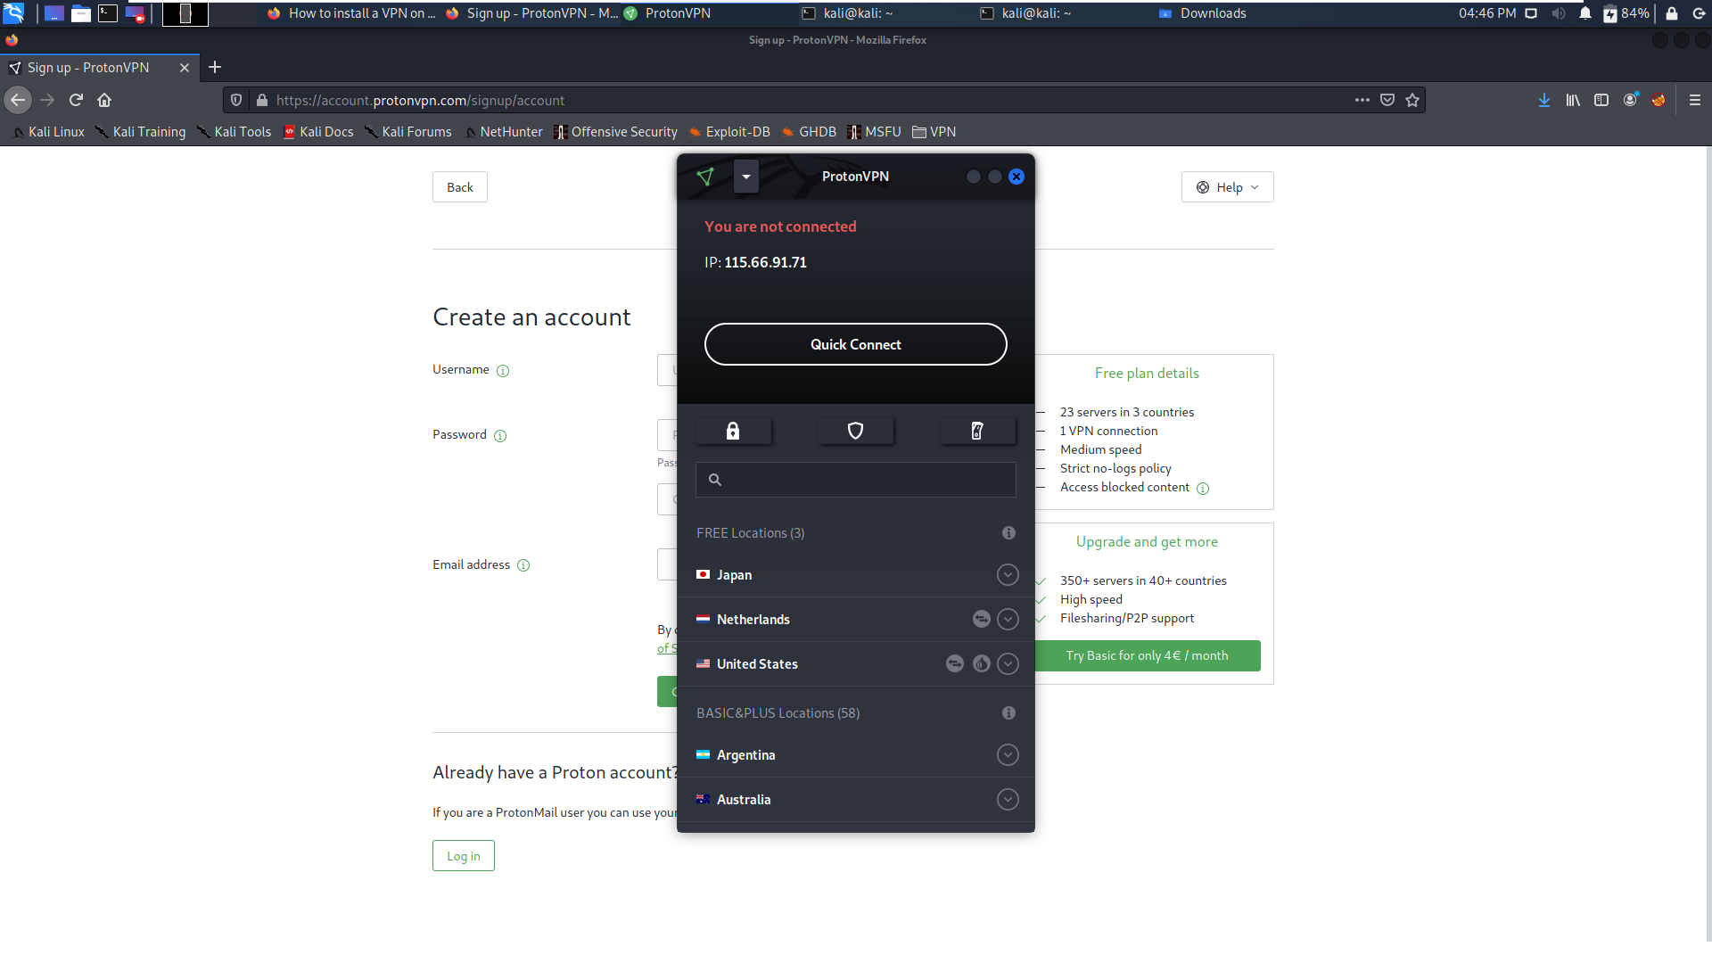

Slide 16
Tor Browser

Slide 17
How to install Tor Browser on Kali Linux?
Update the apt package list
sudo apt update
Install the app
sudo apt install -y tor torbrowser-launcher
Run the following command:
torbrowser-launcher

Slide 18
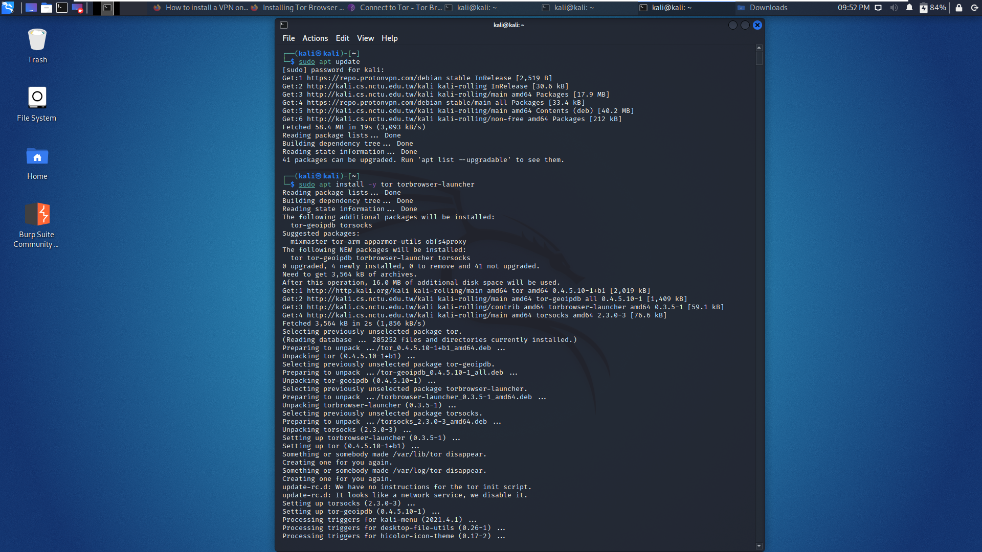

Slide 19
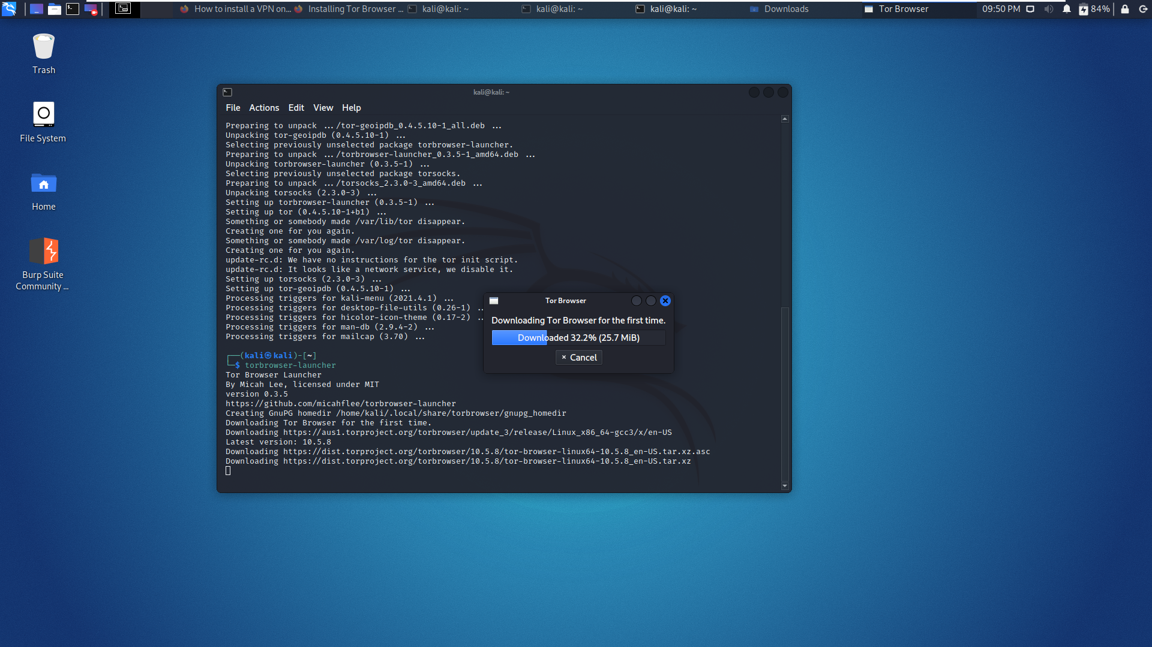

Slide 20
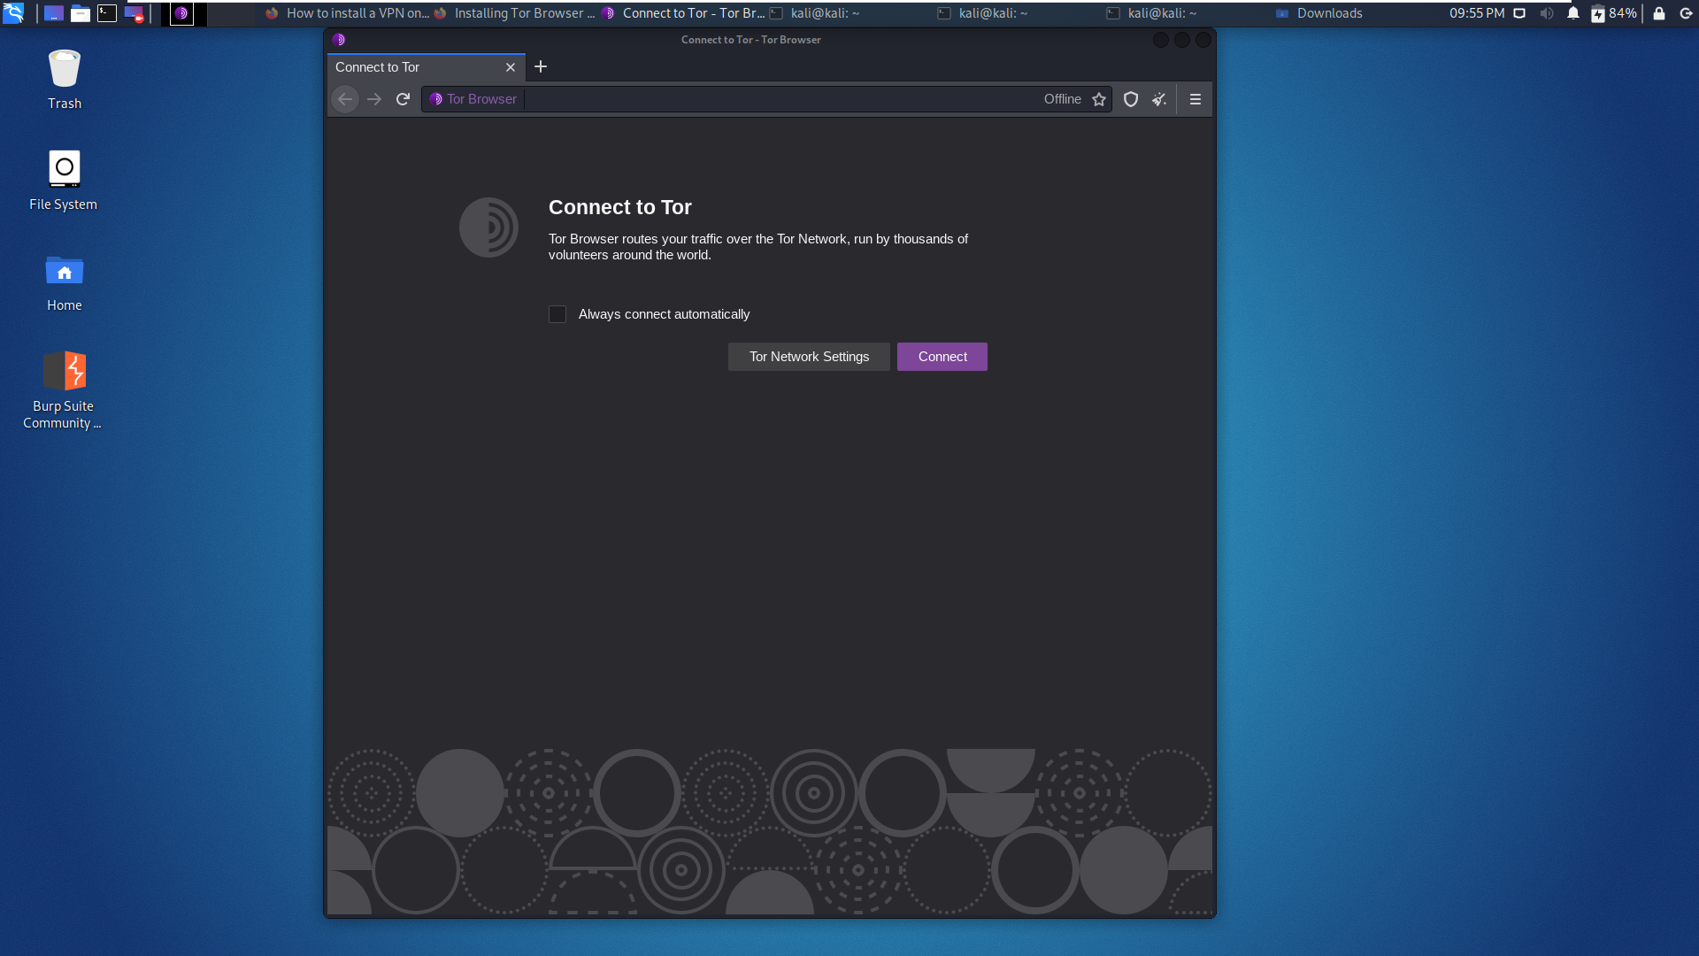

Slide 21
